Slide 1
Advanced HIV
Seed Educator Immersion Training
Zambia Guidelines for Management of Advanced HIV
Table of contents
Quick reference

Slide 2
Definitions
TB
Screening
Severe Bacterial
Prophylaxis
Respiratory Fungal
ART Initiation
Gastrointestinal
CNS Infections
Malignancies

Slide 3
Quick Reference
Screening for OIs
Prophylaxis in AHD
ART initiation
Cryptococcal meningitis
Tuberculosis
Severe bacterial infections
Other CNS infections
Respiratory fungal infections
Oral/Esophagitis
Acute diarrhea
Persistent diarrhea
GI opportunistic infections
Malignancies

Slide 4
Definitions
What are the definitions of the following terms:
Advanced HIV
Severely immunocompromised
Seriously ill adult/adolescent
Seriously ill child
Unstable
Non-adherent

Slide 5
Screening for AHD
How should AHD be screened for?
When is AHD screening initiated?
How often should AHD be screened for?
When should AHD screening stop?
How often does screening occur for children < 5 years old?

Slide 6
Prophylaxis in AHD
What are the indications for prophylaxis in AHD?
What medication is used?
What are key infections that are prevented?

Slide 7
ART initiation
When is rapid ART initiation considered?
When is ART delayed?
How long should ART be delayed in those circumstances?

Slide 8
Cryptococcal meningitis
How does cryptococcal meningitis typically present?
What is the treatment?
When are lumbar punctures indicated?
How is treatment response monitored?
When is pre-emptive treatment indicated?
When is prophylactic treatment indicated?

Slide 9
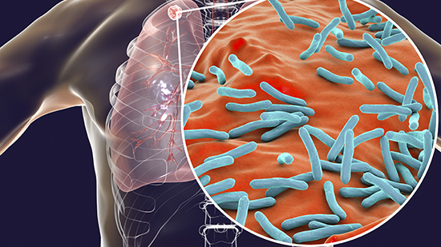
Tuberculosis
Who should be screened and how?
What is the preferred diagnostic test?
Who should receive prophylactic treatment?
What is the treatment for tuberculosis?
When should ART be started with TB co-infection?

Slide 10
Severe bacterial infections
What are the most likely organisms causing
Bacterial meningitis
Bacterial pneumonia
Genitourinary bacteremia
Gastrointestinal bacteremia
Unknown source of bacteremia
What is the empiric treatment of each?

Slide 11
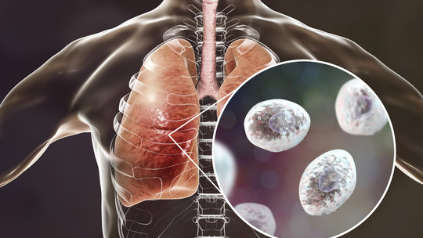
Respiratory Fungal Infections
What are the fungal organisms that cause a pneumonia clinical picture?
What is the treatment of each?

Slide 12
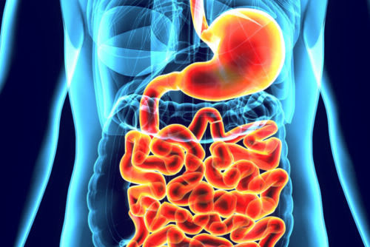
Gastrointestinal
What are the causes of oral and esophageal infections and their treatment?
What are causes and management of acute diarrhea?
What are causes and management of persistent diarrhea?
What is the diagnosis and treatment for each of the GI OIs?

Slide 13
Malignancies
Which cancers are AIDs defining cancers?
What other cancers are associated with HIV?
What are the recommendations for screening for cervical cancer in HIV positive women?

Slide 14
Definitions
Pg 2, 7, 8
Advanced HIV: CD4 < 200 or WHO stage 3 or 4 and all children < 5yo
Severely immunocompromised: CD4 < 50
Seriously ill adult/adolescent: altered mental status, BP < 90/60, RR ≥ 30, HR ≥ 120 or unable to walk, can consider T ≥ 39 with headache or seizures
Seriously ill child: lethargy, unconscious, convulsions, unable to drink, repeated vomiting. Can consider T ≥ 39 with tachycardia or tachypnea
Unstable: On ART > 1 year and any of the following
Not virally suppressed, CD4 < 200, adverse drug reaction requiring ongoing monitoring, pregnant, breastfeeding, active opportunistic infection, substance abuse, mental illness, co-morbid conditions requiring frequent follow, up non-adherent with ART,
Non-adherent: ≥2 missed doses/month if on daily regimen, ≥4 missed doses/month if on BID regimens, missed medication pick ups

Slide 15
WHO Staging
Stage | Severity | Conditions
1 | Asymptomatic | OR persistent generalized lymphadenopathy of at least 2 sites (not including inguinal) x > 6mo
2 | Mildly symptomatic | Unexplained weight loss < 10% TBW Recurrent respiratory infections Derm (Herpes zoster, recurrent oral ulcerations, popular pruritic eruptions, angular cheilitis, seborrheic dermatitis, onychomycosis)
3 | Moderately symptomatic | Weight loss > 10% TBW Prolonged (> 1mo) unexplained diarrhea Pulmonary TB Severe systemic bacterial infections (PNA, pyelo, empyema, pyomyositis, meningitis, bone/joint infections, bacteremia) Mucocutaneous conditions (recurrent oral candidiasis, oral hairy leukoplakia, acute necrotizing ulcerative stomatitis/gingivitis/periodontitis)
4 | Severely symptomatic (AIDS-defining illnesses) | HIV wasting syndrome PCP pneumonia Recurrent severe or radiological bacterial pneumonia Extrapulmonary TB HIV encephalopathy CNS toxoplasmosis Chronic HSV infection (orolabial, genital, or anorectal > 1mo duration) Esophageal candidiasis Kaposi’s sarcoma

Slide 16
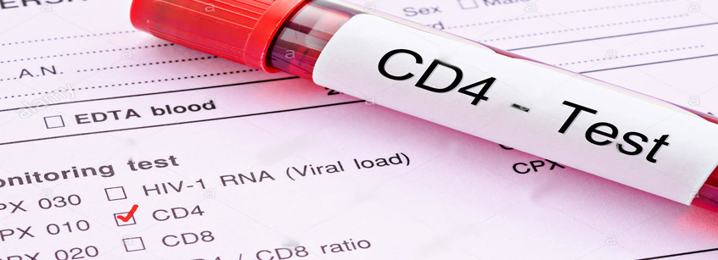
How: CD4 count
When: At initiation of therapy, returning to care, switching therapy after treatment failure, develops WHO stage 3 or 4, HIV load > 1000 copies
How often: Repeat at 6 and 12 months
Discontinue after 2 consecutive CD4 counts > 350
All children < 5 years old should have a CD4 count every 6 months
Annually if ≤ 350
Screening for AHD
Pg 3

Slide 17
Screening for Opportunistic Infections
What opportunistic infections are screened for in AHD?
How are those infections screened for?

Slide 18
Screening for Opportunistic Infections
Pg 4, 12, 20
Cryptococcal meningitis
Rapid blood, plasma or serum cryptococcal antigen test
CrAg, CAT
Tuberculosis screening with all of the following
Lipoarabinomannan (LAM) test (CD4<200 IP, CD4<100 OP) sensitivity (37-56%) increases with severity of illness/specificity (95%)
Chest x-ray
Symptom review: cough, fever, weight loss, night sweats, chest pain, feeling unwell

Slide 19
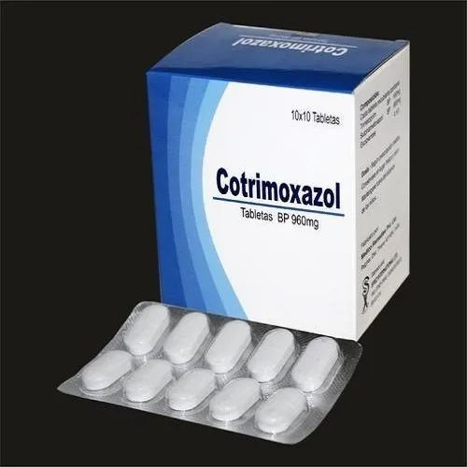
Prophylaxis in AHD
Pg 4,5,19, 41
Cotrimoxazole (trimethoprim sulfamethoxazole) 960mg: bacterial infections, toxoplasmosis, PJP and parasitic infections
CD4 < 350
Fluconazole 100mg daily prophylaxis if CD4 < 100 and Cryptococcal antigen screening not available
Fluconazole pre-emptive treatment: Asymptomatic and Cryptococcal antigen positive with negative CSF
1200mg daily x2 weeks → 800mg x 8 weeks→ 200mg daily. Minimum duration of 1 year, stop after CD4 >200 in two consecutive tests six months apart
WHO 800-1200mg x2 week → 400-800mg x 8 weeks → 200mg daily until CD4 > 200 and suppression of viral load
Tuberculosis Prophylactic treatment
All patients with AHD
Given every three years
Isoniazid 300mg + Pyridoxine 50mg x6 months
Isoniazid 300mg + Rifampicin 300mg x3 months
Isoniazid 15mg/kg weekly + Rifapentine weight based weekly x3 months

Slide 20
Initiation of ART
Pg 4,5,14
Rapid Initiation
Within 7 days of diagnosis to screen, identify and treat opportunistic infections
Delay
2 weeks after starting antituberculosis treatment
2 weeks after starting pre-emptive (asymptomatic, CrAg positive and CSF negative) or prophylactic cryptococcal meningitis treatment
4-6 weeks (WHO) or 8-10 weeks after starting cryptococcal meningitis treatment

Slide 21
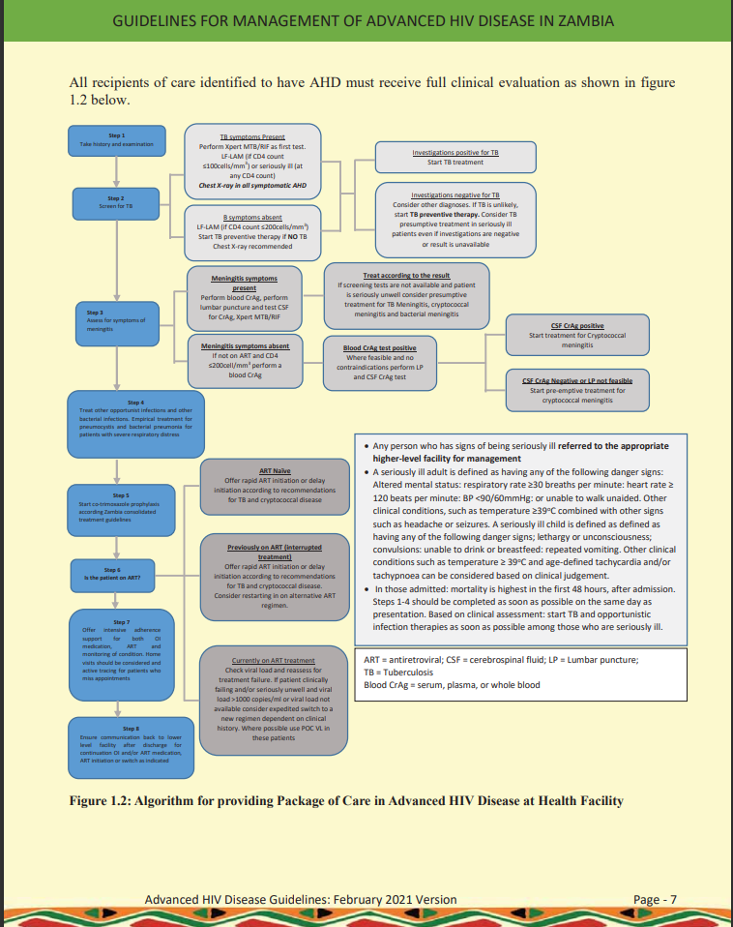
ART Initiation Algorithm
Figure 1.2 on page 7

Slide 22
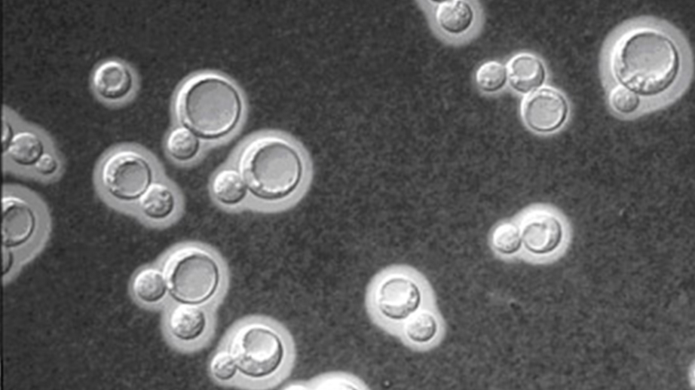
Cryptococcal Meningitis
Insidious onset over 4 weeks
Headache, fever, lethargy, memory loss, cranial nerve palsies, increased plantar reflex, rash, meningism, coma
Usually have a CD4 count < 100
Cryptococcal antigen positive and symptomatic or CSF positive
Induction, consolidation and maintenance antifungal treatment
Fluconazole, Amphotericin B and Flucytosine
Steroids are contraindicated unless used by a specialist
Lumbar puncture with diagnosis and repeat early LP with opening pressures for raised ICP
Repeated as needed by recurrence of signs or symptoms of ICP
Monitor and manage A.E. of medications
Monitor treatment response clinically not with lab studies. If there persistent/recurrent symptoms beyond 2 weeks, it’s likely due to inadequate amphotericin B will need to repeat LP and get CT head.
Treat pre-emptively in asymptomatic patient with a positive Cryptococcal antigen and negative CSF
Treat prophylactically if CD4<100 and CrAg testing is not available
Pg 12-18

Slide 23
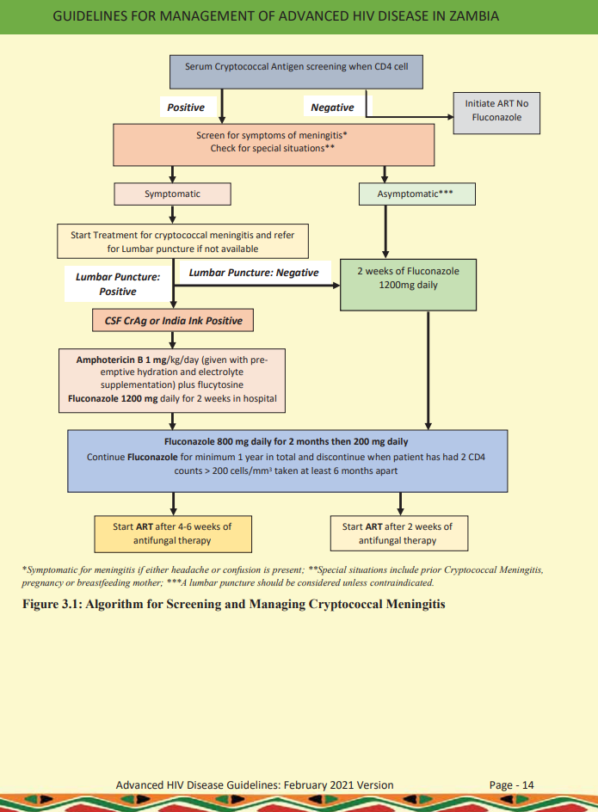
Cryptococcal meningitis treatment
Figure 3.1 Pg 14

Slide 24
Other CNS infections
CMV, toxoplasmosis, HSV, JCV, EBV, VZV
CMV, CD4<100
Retinitis: blurry/loss of central vision, blind spots, floaters, flashing lights.
Encephalitis: confusion and lethargy, rapid progression to death. All patients have CMV disease, usually retinitis. Present with nystagmus, ataxia and cranial nerve palsies.
Polyradiculopathy: ascending lower extremity weakness with diminished reflexes. Can have urinary retention and fecal incontinence
Induction: ganciclovir 5mg/kg IV bid x14-21 days OR Valganciclovir 900mg PO bid x21 days
Post treatment suppression: Valganciclovir 900mg PO until CD4 > 100 x6 months
ART
Toxoplasmosis: CD4<100 not on prophylaxis and seropositive for T gondii by IgG or antigen in blood or CSF, ring enhancing lesions on brain
Cerebritis with headache, fever, seizures
Retinitis similar to CMV retinitis
First line TMP/SMX 10mg/kg x6 weeks OR Pyrimethamine 75mg daily and sulfadiazine 1000mg QID x6weeks
Secondary prophylaxis with Bactrim or Dapsone until CD4 persistently >200 and images resolve on MRI
ART
HSV
Necrotizing encephalitis with headache, meningism, vomiting, lethargy, cerebellar symptoms, personality changes, fever
Acyclovir 30mg/kg/day IV
JCV CD4<100 causing Progressive Multifocal Leukoencephalopathy, a demyelinating disease
Weakness, paralysis, vision loss, impaired speech, cognitive deterioration
ART
HIV Associated Neuro-Cognitive Disorder: HAND, HIV-associated dementia, HIV/AIDS encephalitis
Exact mechanism is unknown but may result from HIV infection of cells or inflammatory response to an infection
ART with high CNS penetration
Pg 37-40

Slide 25
Tuberculosis
Pg 19
Leading cause of mortality in patients with HIV
Non-specific symptoms, i.e. general unwellness, anemia, weight loss, without night sweats and fever
Diagnosis is usually dependent on a high index of suspicion
Screen all patient for TB
Diagnostic: Gene Xpert is first line
Sputum smear/culture if gene expert is not available
All HIV infected patients should receive prophylactic therapy
Start ART two weeks after starting treatment for active TB

Slide 26
TB treatment
TB guideline Pg 44
Rifampin
Isoniazid
Pyrazinamide
Ethambutol
R
H
Z
E

Slide 27
Severe bacterial infections
Prophylaxis with trimethoprim-sulfamethoxazole if CD4<350
Pg 35-36
Source | Organism | Empirical Treatment
Bacterial meningitis | S. pneumoniae, H. influenzae, Salmonella, E. coli | Ceftriaxone 2gm BD x10-14 days, add ampicillin if >50yo or pregnant
Bacterial pneumonia | S. pneumoniae | Ceftriaxone 1gm + azithromycin 500mg x5 days Hospital acquired add vancomycin 15-20mg/kg q8-12 hours
Bacteremia
GU | E. coli, gram (-) rods | Ceftriaxone 1g
Intra-abdominal | Salmonella, gram (-) rods, anaerobes, pseudomonas. | Ceftriaxone 2g OR Cipro 400mg IV bid with metronidazole 1g then 500mg tid x10-14 days
Unknown | Salmonella, gram (-) rods, pseudomonas

Slide 28
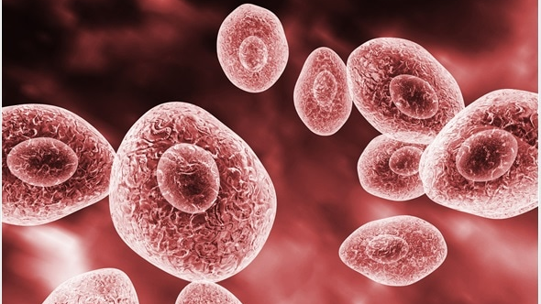
Respiratory fungal infections
Pg 41-43
Pneumocystis Jiroveci Carinii
CD4<200, not on prophylaxis
Fever, non-productive cough, progressive dyspnea, chills, chest pains, crackles, rhonchi, oral thrush
CXR with bilateral symmetrical findings
TMP-SMX 15mg-20/kg (TMP dosing) in divided doses for 21 days
Adjuvant steroids with prednisolone 40mg bid x5 days, then 40mg x5 days then 20mg x11 days if PO2 less than 70mmHg
Secondary prophylaxis until CD4>350 for at least 2 years with a suppressed viral load
Histoplasmosis CD4<100
Most endemic mycosis
Amphotericin B, although itraconazole can be use in mild localized disease
Aspergillosis
CD4<500 presenting as pneumonia, fungal ball fills post TB lung cavity
Amphotericin B, Itraconazole or Vorizonazole
Blastomycosis
Pulmonary and possible skin involvement
Itraconazole
Candida
Can be present on sputum testing but it not a cause pneumonia so do not treat

Slide 29
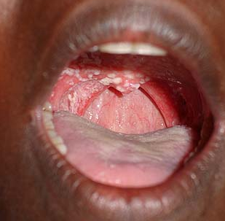
Oral/Esophagitis
Oral candidiasis: often painful and on side and roof of mouth, less frequently on the tongue.
Nystatin 400,000-600,000u QID x7 days or fluconazole 200mg x7-14 days
Esophageal candidiasis: presents with dysphagia or odynophagia
Fluconazole 200mg x14 days
HSV esophagitis: oral blisters, esophageal/gastric ulcers
Mild acyclovir 400-800mg 4-5x/day x10-14 days, Severe IV acyclovir 5-10mg/kg tid
CMV esophagitis: more common than HSV and should be considered if patients do not respond to fluconazole or acyclovir. Need an eye exam to evaluate for CMV retinitis.
IV ganciclovir 5mg/kg bid x 21-42 days or until symptoms disappear OR Valganciclovir 900mg bid

Slide 30
Acute diarrhea
E coli, salmonella, shigella, cholera, campylobacter, C. dif, rotavirus, Norwalk, adenovirus, hepatitis viruses, giardia, entamoeba, medications, food poisoning
Rehydrate orally or if needed intravenously
Stool studies x3 for WBC, gram stain, O&P
Bacteria: Ciprofloxacin 500mg bid or nalidixic acid 500mg qid
Giardia, entamoeba & C. dif: Metronidazole 400mg tid x10-14 days
Empiric: Cipro 500mg bid + metronidazole 400mg tid x7 days

Slide 31
Persistent diarrhea
Often have wasting
Stool studies x3 for wbc, gram stain, O&P
Plus Ziehl-Neelsen for cryptospoidia, Isospora and cyclospora
ART is the definitive treatment
Oral or LR IV fluids, electrolyte correction, nutritional replacement
Loperamide as needed
Empiric treatment: Cipro 500mg bid + metronidazole 400mg tid x7-10 days
If no response: TMP-SMX 960mg QID + metronidazole 800mg tid x10 days
Treats Cystoisospora, Cyclospora, giardia, entamoeba and most bacteria
If patient responds, consider extending TMP-SMX bid an additional 3 weeks to complete Cystoisospora treatment
Still no response add albendazole 400mg bid x3 weeks to treat microsporidiosis

Slide 32
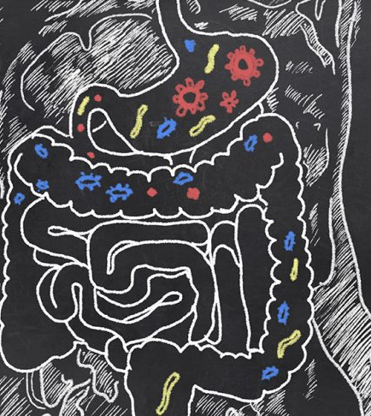
GI Opportunistic Infections
Cryptosporidiosis: intracellular protozoan with fecal oral transmission, if CD4>100 diarrhea can be self limited for 2-8 weeks.
Diagnosed with modified ZN stain
No proven effective treatment. Need ART.
Symptomatic treatment with loperamide, bismuth, aggressive rehydration, electrolyte replacement
Consider Nitazoxanide 500mg bid for 2-4 weeks for refractory cases
Cystoisosporiasis: protozoan with fecal oral transmission
Diagnosed with modified ZN stain
TMP-SMX 960mg QID x 10 days followed by BID x21 days
If refractory continue treatment until immune reconstitution
Microspoidiosis: water borne protozoan
Diagnosed by modified trichome stain
Albendazole 400mg bid x3 weeks
CMV colitis: CD4<50, extensive mucosal hemorrhage and perforation can be life threatening
Diagnosed with biopsy
Induction: ganciclovir 5mg/kg IV bid x14-21 days OR Valganciclovir 900mg PO bid x21 days
Post treatment suppression: Valganciclovir 900mg PO until CD4 > 100 x6 months
Mycobacterium Avium Complex: CD4<50, can present with systemic symptoms
Anemia, pancytopenia, elevated alk phos and LDH, diagnosed by blood culture but bone marrow biopsy if preferred
Negative Xpert with positive sputum or tissue AFB
Clarithromycin 500mg BD OR azithromycin 600mg QD + Ethambutol 15mg/kg/day PO + Rifabutin 300mg QD
IRIS is common

Slide 33
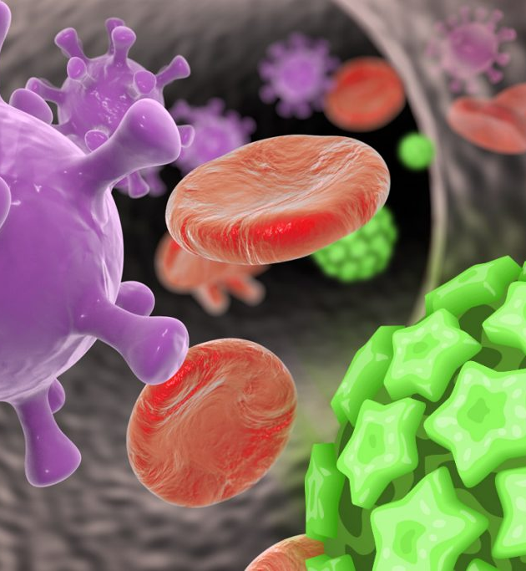
Malignancies
Pg 52-56
AIDs defining cancers: Kaposi sarcoma, aggressive B-cell non-Hodgkin lymphoma, cervical cancer
Non-AIDs defining cancers: colorectal, lung, hepatocellular, oral/pharyngeal/esophageal, bronchogenic, Hodgkin's
Kaposi sarcoma: HHV-8, prognosis is poor with advanced HIV or systemic involvement
Can affect skin, mucous membranes, lymphadenopathy, respiratory, GI, cardiovascular and ocular systems
There is no consensus treatment. Mild – ART. Chemotherapy for severe cutaneous, disseminated and KS not responding to ART.
HIV-related lymphoma: present with advanced stage, constitutional symptoms, extra nodal involvement and in unusual locations.
Increased risk for oncologic emergencies
Consider when there is a suboptimal response to empiric or presumptive OI treatment
Cervical cancer: most common cancer in women in Zambia
Start screening within 1 year of sexual activity, repeat yearly for 3 years then every 3 years if on ART with adequate CD4 count and low viral load

