Slide 1
Echocardiography: An Introduction
Matthew S. haldeman, md MPH

Slide 2
Echo: overall outline
Part 1
Overview/Anatomy Review
Parasternal Long Axis View
Technique
Estimating LV EF
LA, LVOT, RV size
LVH screen
Parasternal Short Axis View
Technique
3 views
Method to look for wall motion abnormality, IVS movement, RV size
Apical 4-Chamber View
Technique
Valve regurgitation
RV size, (60% rule, wall thickness), function
Subxiphoid View
Technique
Effusion
Part 2
Normal views
Pathology
LAE
HFrEF
HFpEF
LVH
Hyperdynamic LV
LV wall motion abnormality
RVH
Elevated R-sided pressure
MV stenosis
MV, AV, TV regurgitation
Effusion
Tamponade
PE (McConnell’s sign)
Thrombus
Vegetation

Slide 3
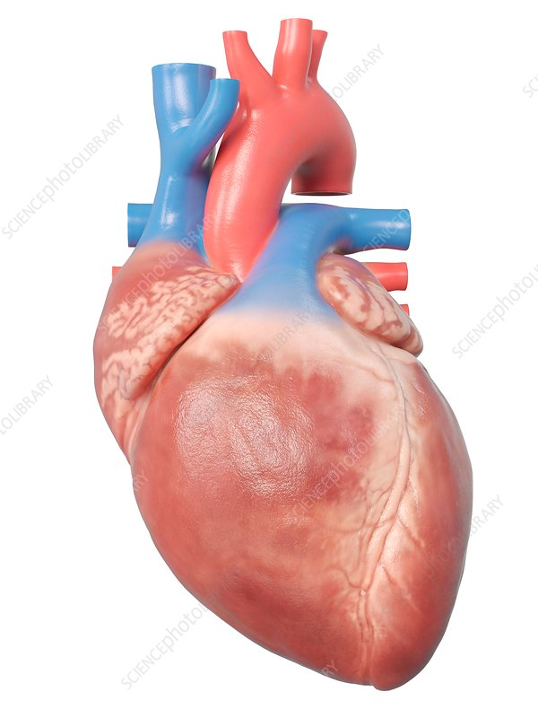
Heart anatomy
Base of Heart
Apex of Heart

Slide 4
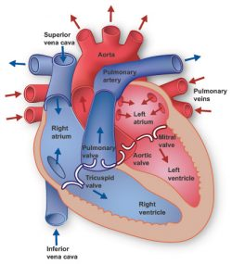
Heart Anatomy

Slide 5
Echo: some Abbreviations
Chambers
LV: Left ventricle
LA: Left atrium
RV: right ventricle
RA: right atrium
LVOT: LV outflow tract
Valves
MV: mitral valve
TV: tricuspid valve
AV: aortic valve
PV: pulmonary valve
Others:
EPSS: E-point septal separation
TAPSE: tricuspid annular plane systolic excursion
LVH: left ventricular hypertrophy
LVMI: left ventricular mass index
IVS: Interventricular septum

Slide 6
Echo: basic principles
Image Quality: The 3 questions for every image:
Depth correct?
Gain correct?
Cut correct?
Notes:
In echo, image quality is VERY important. If quality is poor, interpretation can be easily misled.
-- Ask yourself these questions on every echo image obtained to ensure quality.

Slide 7
Echo: simplified method for quick scanning
The 5 E’s:
Ejection fraction
Effusion
Equality (RV vs. LV)
Exit (aortic root)
Entrance (IVC)
Notes:
I recommend starting here!

Slide 8
complete 4-view basic Echo: interpretation goals
Chamber size
LA: dilation?
LV: dilation? hypertrophy?
RV: dilation? hypertrophy?
RV: elevated pressures?
Chamber function
LV function (systolic: ejection fraction)
LV function (diastolic)
LV function (wall motion abnormality)
RV function
Valves
MV: stenosis? Regurgitation?
TV: regurgitation?
AV: regurgitation?
Effusion
Present or absent?
Tamponade present?
IVC
Elevated R-sided heart pressures or hypervolemia?
Hypovolemia?
Notes:
These are the questions we’re trying to answer with a beside echo. **We will not be doing this with every echo—in an emergent situation, we will only be looking for a few specific things. But This list encompasses the breadth of what we can answer with POCUS

Slide 9
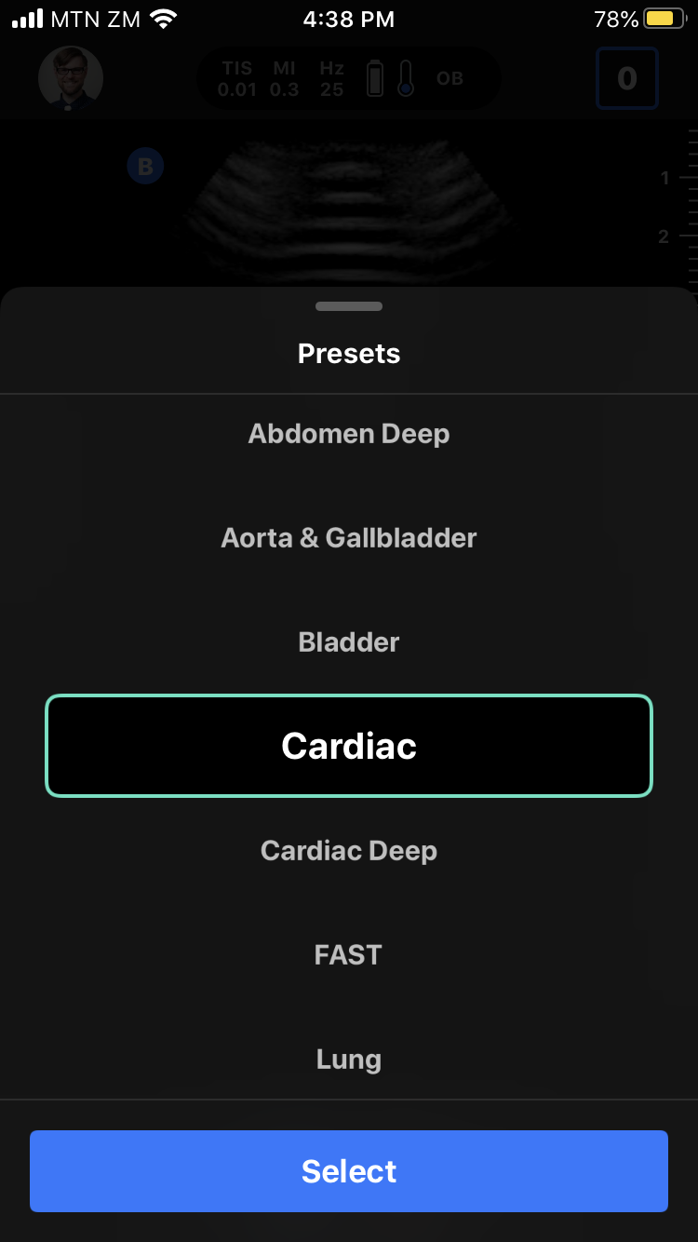
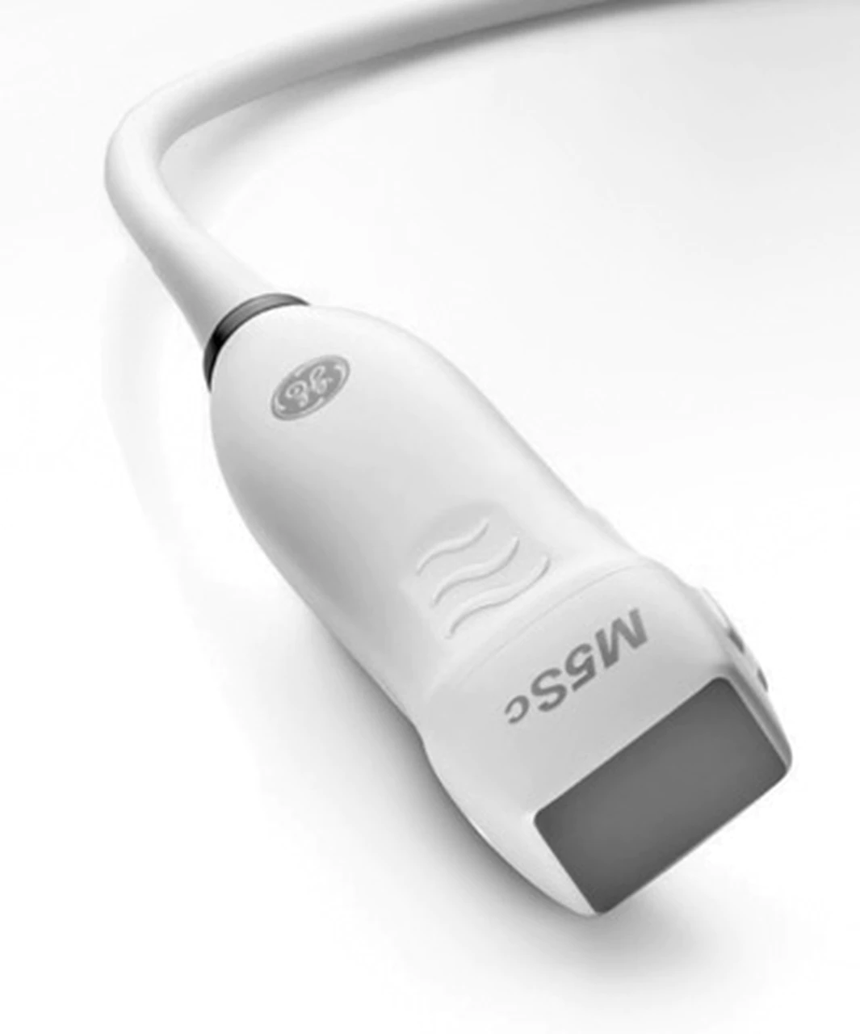
Positioning, probe, preset
Patient positioning: supine on bed
Better: Left lateral decubitus position
Ultrasound probe:
Phased Array probe (or Butterfly probe)
Preset: Cardiac

Slide 10
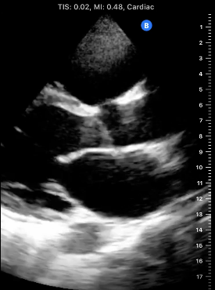
Echo: image orientation marker
Notes:
Note probe marker is on the opposite side of the image for cardiac imaging

Slide 11
Echo: 4 major views
Parasternal Long Axis (PLAX)
Parasternal Short Axis (PSAX)
Apical 4 Chamber View (A4CV)
Subxiphoid View (SX)
Notes:
There are more views than this in echo. But these are the 4 views of a basic echo.

Slide 12
Parasternal long axis view (PlaX)

Slide 13
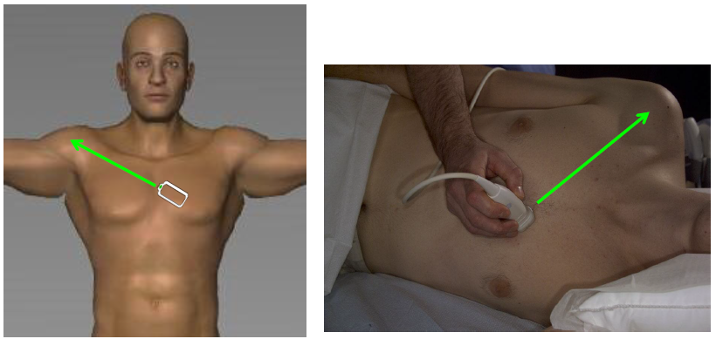
Parasternal long axis view (PLAX)
Technique:
Place probe to left of the sternum, between ribs 2-5
Direct probe marker towards patient’s R shoulder
Image: University of South Carolina School of Medicine

Slide 14
Window shopping…
It often requires a lot of probe sliding to find an adequate window to see the heart between the ribs…
Start with large movements to find a window
Once heart is visualized, use fine movements to optimize the image

Slide 15
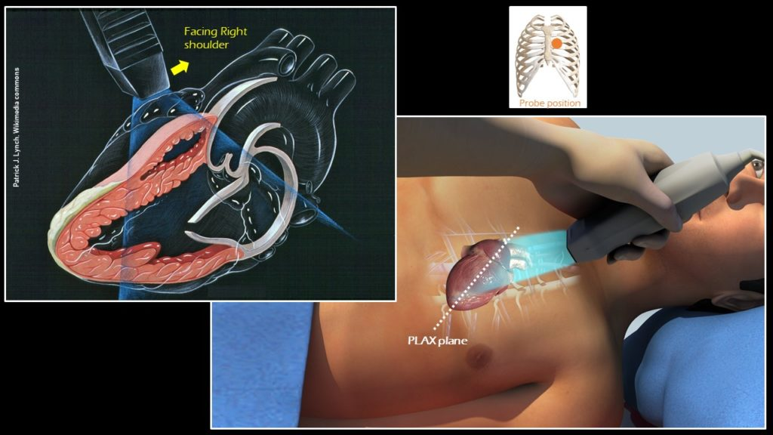
Plax view

Slide 16
Inter-
Ventricular
Septum
(IVS)
RV
Aortic Root
LVOT
LV
Aortic
Valve (AV)
LA
Mitral Valve
Leaflets
Descending aorta*
LV Posterior
Freewall
*Indicates depth of image is adequate

Slide 17
PLAX view: normal heart
Notes:
This is from MH Butterfly 5.19.20

Slide 18
PLAX view: normal heart
Notes:
This is my heart
Good teaching echoes: 8/25/20 (all 4 views are good for CCF); 10/7/20 has really nice PLAX/PSAX views of CCF

Slide 19
Plax view used for…
Estimating EF (via EPSS)
Evaluating chamber size (LA, LVOT, RV)
Evaluating for LVH (via LVMI)
Screening for valvular disorders
Look for mitral stenosis
Can use color doppler to screen for MV/AV regurgitation
PLAX is the easiest view to see AV regurgitation
A4CV is best for color doppler to look for MV/TV regurgitation

Slide 20
Estimating Ejection fraction: e-point septal separation (EPSS)
In PLAX view of normal heart, the MV leaflet tip should almost touch the IVS during diastole
By measuring the shortest distance between MV leaflet tip and IVS, can estimate EF
EF = 75.5 - 2.5(distance in mm)
EPSS <5mm, EF = normal (>50%)
EPSS >7mm, EF <50%
EPSS >10mm, EF <35%
EPSS >18mm, EF <30%
But…confounders:
AV regurgitation
MV stenosis
Thickened IV septum (LVH, Hypertrophic Obstructive CMP)
MV replacement

Slide 21
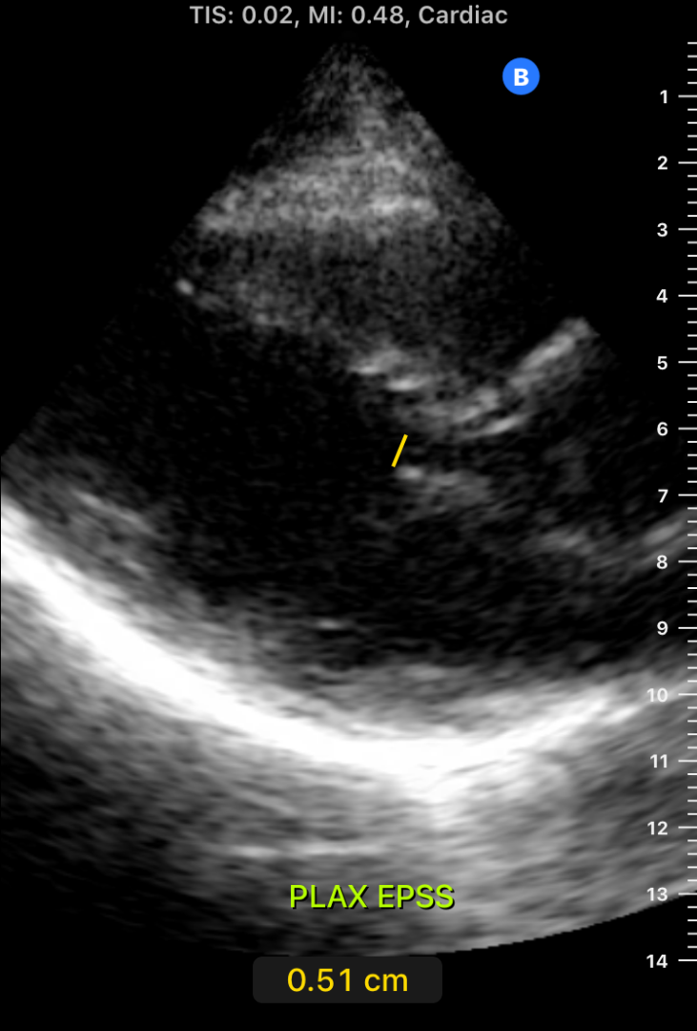
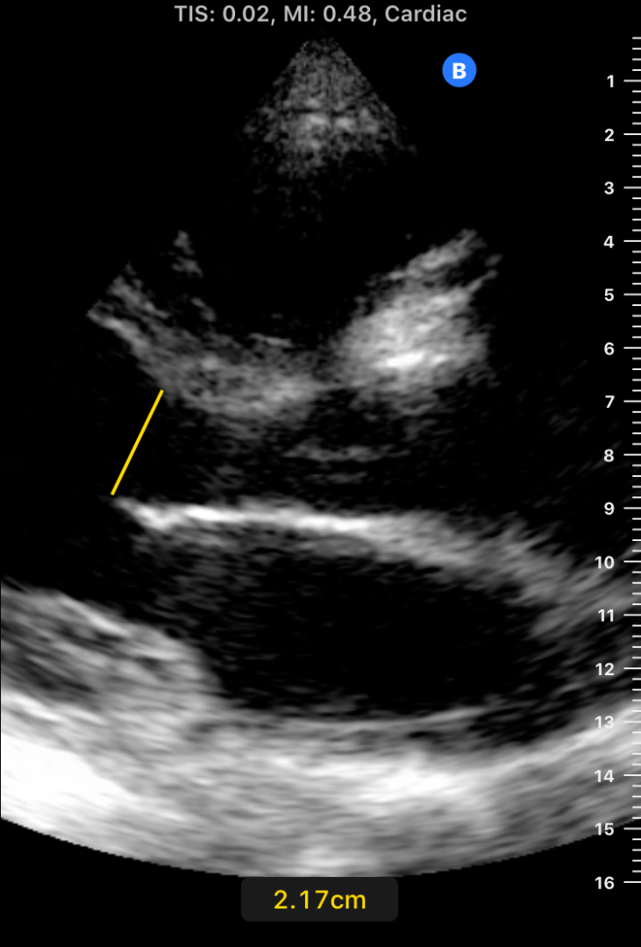

Slide 22
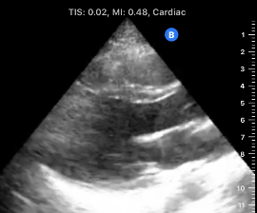
Plax: chamber size
“Rule of Thirds”
LA, LVOT, and RV should all appear approximately the same size in PLAX view
3
2
1

Slide 23
Plax: screening for lvh
Left Ventricular Mass Index (LVMI)
Measure the following parameters at level of MV leaflet tips:
LV end-diastolic diameter (LVEDD)
IVS diameter (IVSd)
LV Posterior Wall diameter (PWd)
Insert values into calculator, along with pt’s height/weight/gender, to obtain LVMI
LVMI normal values:
Male: <115 g/m²
Female: <95 g/m²
Calculator:
http://www.csecho.ca/wp-content/themes/twentyeleven-csecho/cardiomath/?eqnHD=echo&eqnDisp=lvmlvmi
Notes:
This calculator will also tell whether it’s eccentric (e.g., dilation) or concentric hypertrophy (e.g., thickened LV walls)

Slide 24
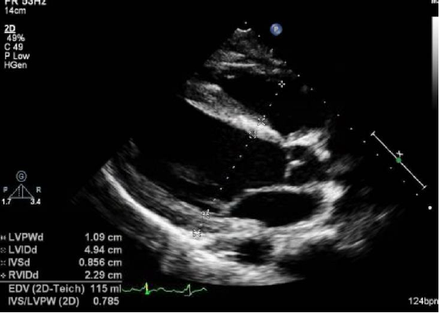
LVMI measurements
IVSd
LVEDD
Pwd
Image: University of South Carolina School of Medicine
Notes:
Measure at level of MV leaflet tips

Slide 25
Plax: screening for valve regurgitation
Notes:
This video loop shows normal flow over the AV—note there is no light blue/orange regurgitant jet re-entering the LVOT from the AV

Slide 26
Parasternal short axis view (PsaX)

Slide 27
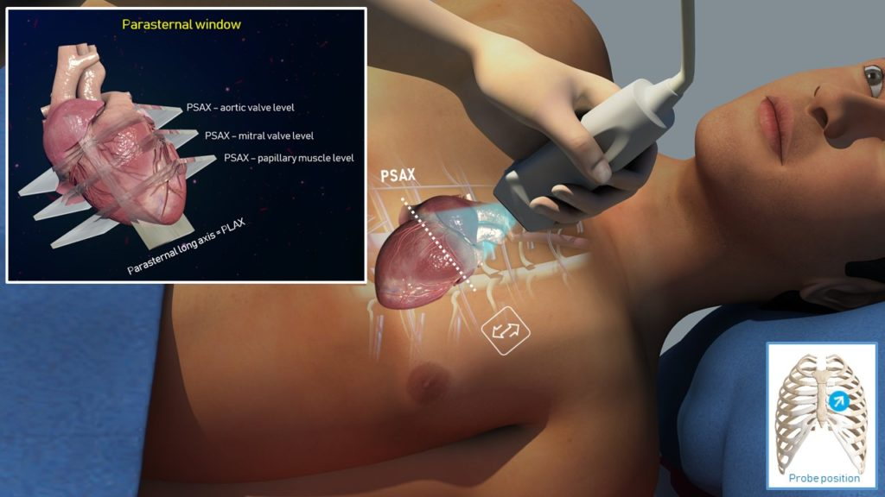
Parasternal short axis view (psax)
Technique:
From the PLAX probe position, rotate probe 90 degrees so that probe marker is now facing patient’s LEFT shoulder

Slide 28
Psax: 3 views
PSAX has 3 major views to obtain:
PSAX Aorta (“Mercedes Benz view”)
PSAX Mitral (“Fishmouth view”)
PSAX Mid-Papillary/Apex (“Money view”)
**All are obtained by fanning the probe slightly. The probe itself is stationery on the chest wall

Slide 29
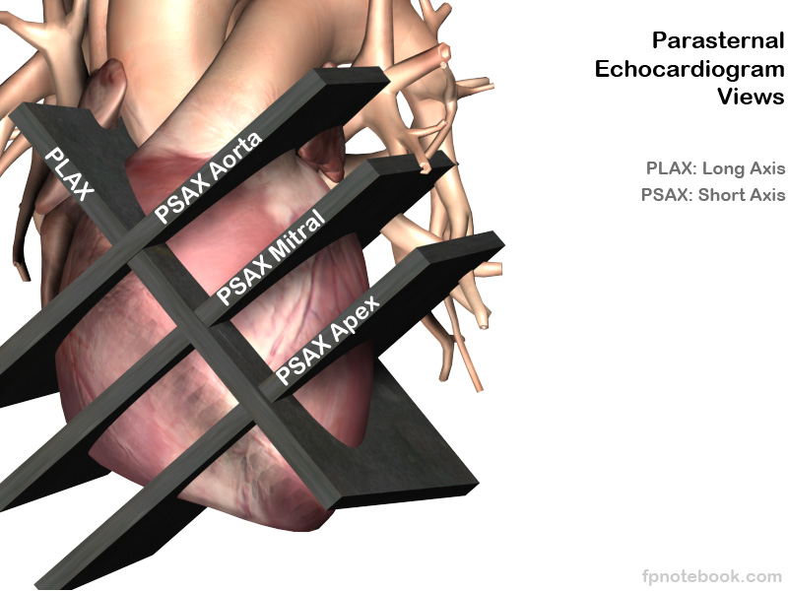
PSAX: 3 views

Slide 30
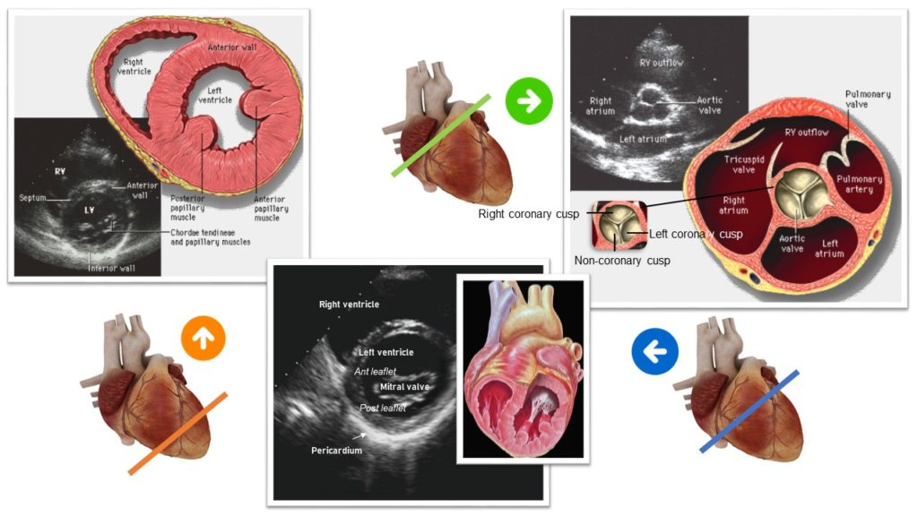
Psax view ANATOMY
PSAX aorta
PSAX mid-papillary
PSAX mitral

Slide 31
Psax aorta: “mercedes benz view”

Slide 32
Psax mitral: “fishmouth view”
Notes:
This image is my heart during our demonstration from Sept. with Kunka, Mpundu, Zimba

Slide 33
Psax mid-papillary: “Money view”

Slide 34
Psax is used for…
Evaluating for wall motion abnormality
All 4 sides of LV wall should be contracting towards the center of the LV chamber EQUALLY and constrict ~1/3 of width
Evaluating for elevated RV pressure
Watch IVS: should stay round throughout (should not flatten during diastole)
Look at LV shape: should stay circular throughout
Look at RV chamber size in relation to LV size
Cannot measure RV size here, but can estimate if it appears large…RV diameter should be < LV diameter
Estimating LV EF
Experts estimate EF from this view by “eyeball method”

Slide 35
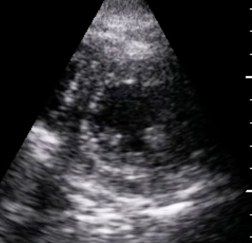
Psax evaluation
RV size
IVS movement
In diastole
Notes:
Watch IVS movement in diastole. It should keep a rounded appearance, bulging into the RV lumen in diastole. If it flattens—this is a “D-shaped” septum and indicates elevated R-sided heart pressures

Slide 36
Psax evaluation
LAD
RCA
LCX
Image: globalultrasoundinstitute.com
Notes:
Note coronary vessel distributions when looking for wall motion abnormalities in PSAX

Slide 37
Estimating EF from psax
https://www.renalfellow.org/2019/08/07/focused-cardiac-ultrasound-abnormalities-on-the-parasternal-short-axis-view/
On this website note:
Differences in normal vs. depressed LV EF
Signs of elevated RV pressure

Slide 38
Apical 4-chamber view (a4cv)
Notes:
This is the hardest of all views to obtain (in my opinion!)

Slide 39
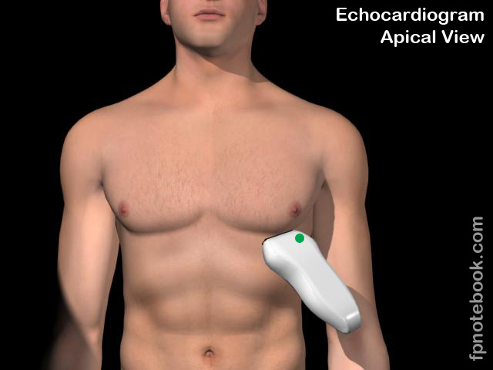
Apical 4-chamber view (a4cv)
Technique:
Place probe at heart apex (5th intercostal space, anterior axillary line, near nipple)
Direct probe marker towards patient’s L axilla, then fan probe towards pt’s R shoulder
Notes:
Really nice A4CV: 7/14/2020 in MH Butterfly Archive
--

Slide 40
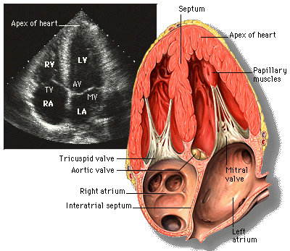
A4cv anatomy

Slide 41
a4cv

Slide 42
A4cv is used for…
Evaluating RV:
Size: width of RV should be <60% of LV width at valve level
Function: Tricuspid Annular Plane Systolic Excursion (TAPSE)
Hypertrophy: RV freewall thickness
Other signs of elevated pressures: apical dominance, McConnell sign*
Evaluating valves with color doppler:
MV stenosis, regurgitation
AV regurgitation
TV regurgitation
Evaluating for tamponade*
*will discuss in Part 2

Slide 43
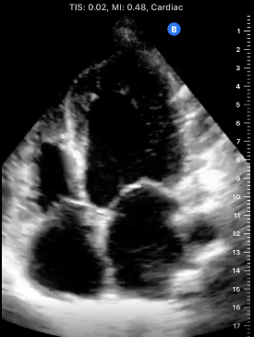
A4cv: RV size
Width of RV should be <60% of LV width at valve level

Slide 44
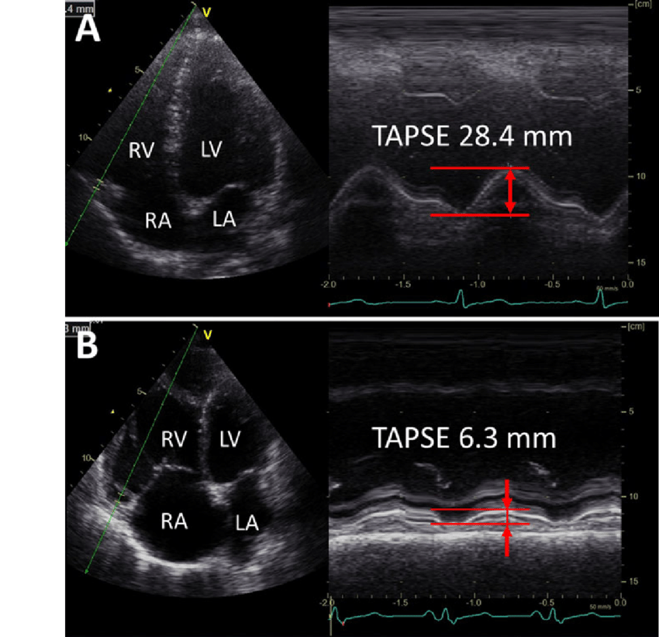
A4cv: tapse for rv function
Notes:
TAPSE: tricuspid annular plane systolic excursion (>17mm is no RV fxn; <16mm is reduced RV fxn)

Slide 45
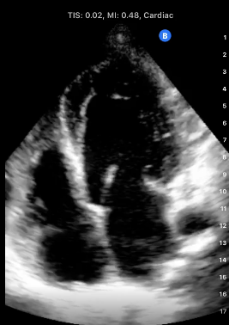
A4cv: RV freewall thickness
Width of RV freewall should be <5mm at end-diastole
Measure when MV/TV are open

Slide 46
A4cv: color doppler to look for valve regurgitation
Notes:
This is normal color doppler flow over the TV. **No light blue/orange jet regurgitating back into the RA from the RV

Slide 47
Subxiphoid view (sx) (or subcostal view)

Slide 48
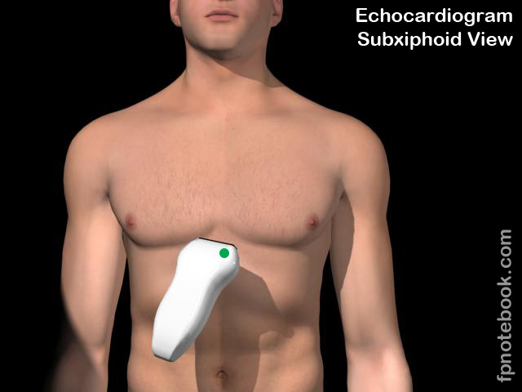
Subxiphoid view (sx)
Technique:
Place probe in epigastrium, “scoop” under xiphoid process
Direct probe marker towards patient’s L flank

Slide 49
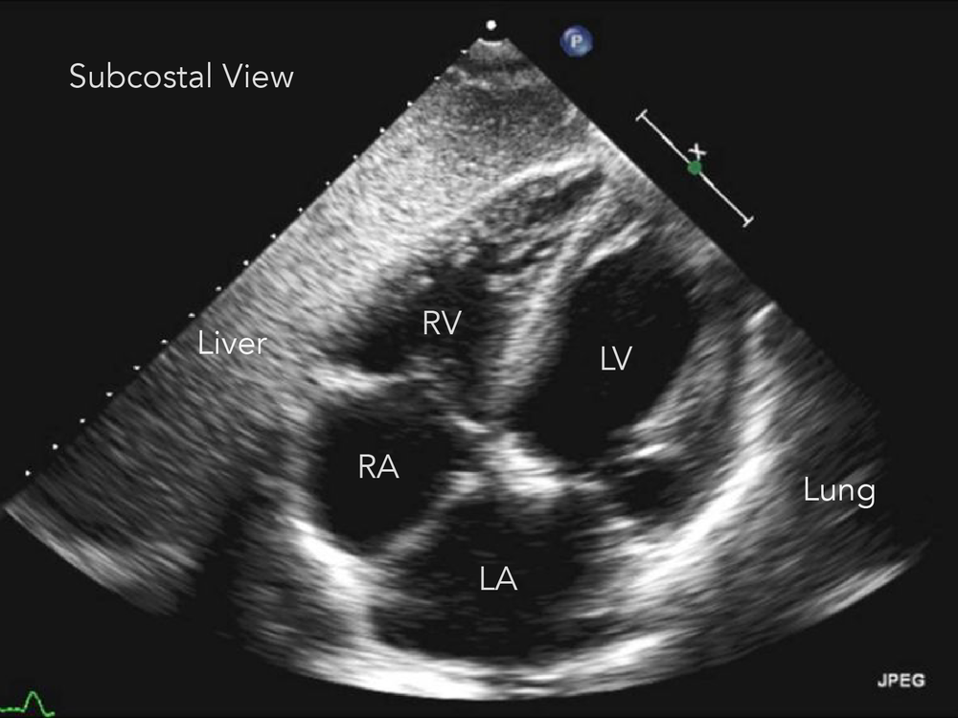
Sx view anatomy
Notes:
The R heart is always adjacent to the liver

Slide 50
Sx view: normal heart
Notes:
Note—sometimes you’ll see a very thin black line between the R heart and the liver, which looks like a small effusion. If it disappears in diastole—is it pericardial fat, not an effusion. If it persists = effusion

Slide 51
Sx view is used for…
Evaluating for pericardial effusion
SX view is the BEST to screen for effusion
Part of eFAST protocol for trauma patient
Evaluating chamber size
Subjective only
Evaluating valves with color doppler
Similar to A4CV

Slide 52
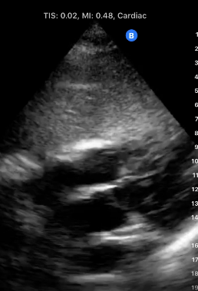
Sx view: where to look for effusion
Will see effusions
In Part 2
Notes:
Red arrows: this is where effusion would be
--pericardium is hyperechoic

Slide 53
basic Echo for beginners
Chamber size
LA: dilation? (PLAX—Rule of Thirds)
RV: dilation? (PLAX—Rule of Thirds; A4CV—60% Rule)
RV: elevated pressures? (PSAX—D-shaped septum and/or RV dilation)
Chamber function
LV function (systolic: ejection fraction) (PLAX—EPSS)
Valves
MV: stenosis? Regurgitation? (PLAX--Visualization; A4CV—Color Doppler)
TV: regurgitation? (A4CV—Color Doppler)
AV: regurgitation? (PLAX—Color Doppler)
Effusion
Present or absent? (SX--Visualization)
IVC
Elevated R-sided heart pressures and/or hypervolemia? (see IVC lecture)
Hypovolemia? (see IVC lecture)

Slide 54
Echo for beginners: tasks for each view
PLAX
Rule of Thirds (for LA, LVOT, RV size)
EPSS (for LV function)
MV stenosis
Color doppler (for MV/AV regurgitation)
PSAX
Relative RV size vs LV size (for RV dilation from elevated RV pressures)
D-shaped septum (for elevated RV pressures)
A4CV
60% rule (for RV size)
Color doppler (for MV, TV regurgitation)
SX
Effusion (present or absent)

Slide 55
Echo for more advanced sonographers
Chamber size
LA: dilation? (PLAX—Rule of Thirds)
LV: dilation? hypertrophy? (PLAX--LVMI)
RV: dilation? (PLAX—Rule of Thirds; A4CV—60% Rule) hypertrophy? (A4CV—RV freewall thickness)
RV: elevated pressures? (A4CV--apical dominance; PSAX—D-shaped septum and/or RV dilation)
Chamber function
LV function (systolic: ejection fraction) (PLAX—EPSS)
LV function (diastolic) (PLAX for LAE and EF, A4CV to assess MV)
LV function (wall motion abnormality) (PSAX—Visualization)
RV function (A4CV—TAPSE)
Valves
MV: stenosis? Regurgitation? (PLAX--Visualization; A4CV—Color Doppler)
TV: regurgitation? (A4CV—Color Doppler)
AV: regurgitation? (PLAX—Color Doppler)
Effusion
Present or absent? (SX--Visualization)
Tamponade present? (A4CV—Signs of Tamponde)
IVC
Elevated R-sided heart pressures/cor pulmonale, tamponade physiology? (see IVC lecture)
Hypovolemia in shock? (see IVC lecture)

Slide 56
Cardiac pathology…
WILL BE TAUGHT IN PART 2, COMING UP!

Slide 57
Questions?

Slide 59
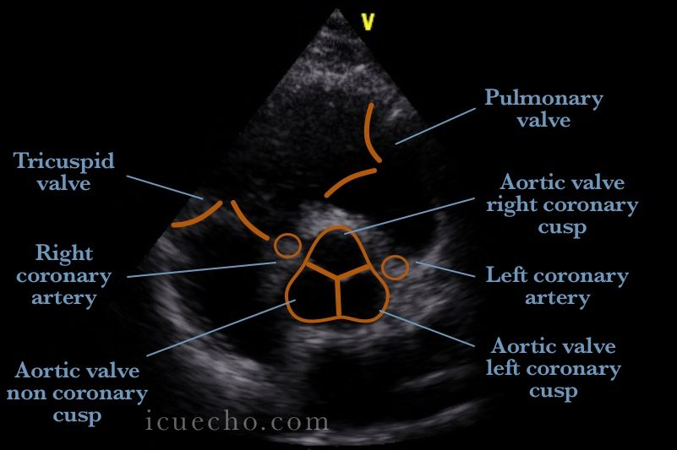
Psax “Mercedes” view anatomy
RV
RVOT
Pulm Trunk
RA
LA

