Slide 1
Point-of-Care Ultrasound for the Zambian Clinician:
An Introduction to Critical Care Ultrasound

Slide 2
ultrasound in undifferentiated shock
Matthew S. haldeman, md MPH

Slide 3
Case
A 25/F HIV+ patient is brought to Casualty for altered mental status. From the little history you can obtain, she has had watery diarrhea for the last 3 weeks and has been bedbound for most of that time. On exam you note the following:
Temp 38.3C HR 120bpm RR 30/min BP 65/35mmHg O2 sat 93% RA
Gen: Thin, emaciated-appearing female patient
ENT: Pale conjunctivae
CV: Reg rhythm but tachycardic, 4/6 systolic murmur
Pulm: Tachypneic but clear bilaterally
Abd: Soft, NT, ND
Ext: 1+ ankle edema bilaterally
Neuro: GCS 7/15. Pupils equal, round, reactive bilaterally

Slide 4
Is this patient in shock???
Notes:
yes

Slide 5
what type of shock could she be in???
Notes:
yes

Slide 6
most likely causes of her shock…
Cardiogenic shock
Clue: LE edema, heart murmur
Hypovolemic shock 2/2 anemia/hemorrhage
Clue: pale conjunctivae
Hypovolemic shock 2/2 fluid losses
Clue: chronic diarrhea
Obstructive shock 2/2 massive PE
Clue: history of immobilization
Distributive shock 2/2 sepsis
Clue: fever, meets sepsis criteria
Others are possible as well!

Slide 7
So how do we manage this patient???
Bolus IV fluids or withhold fluids?
Initiate antibiotics?
Initiate cardiac inotrope such as dobutamine? Dopamine? NE?
Transfuse blood?
Notes:
yes

Slide 8
Types of shock
Hypovolemic
Hemorrhage (internal [AAA rupture, etc.] or external)
Fluid losses (GI, etc.)
Distributive
Sepsis
Anaphylaxis
Adrenal crisis
Neurogenic shock
Cardiogenic
Severe congestive heart failure (pump failure)
Arrhythmia
Valve pathology
Obstructive
Massive pulmonary embolism
Tension pneumothorax
Cardiac tamponade

Slide 9
POCUS in undifferentiated shock

Slide 10
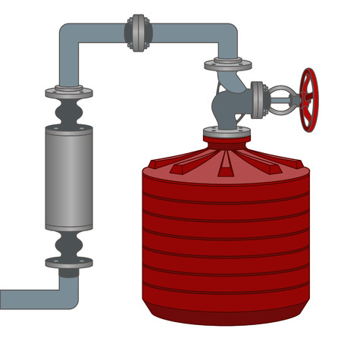
pocus in shock: pump, tank, pipes
Pipes/source
Pump
Tank

Slide 11
Pocus exams for shock
Focused cardiac
Pulmonary
IVC
Select supplemental scans:
Lower extremity DVT
AAA screen
Pulmonary (r/o PNX)
Flanks/pelvis for intraperitoneal fluid (FAST exam)
= RUSH (Rapid Ultrasound for Shock and Hypotension) Protocol

Slide 12
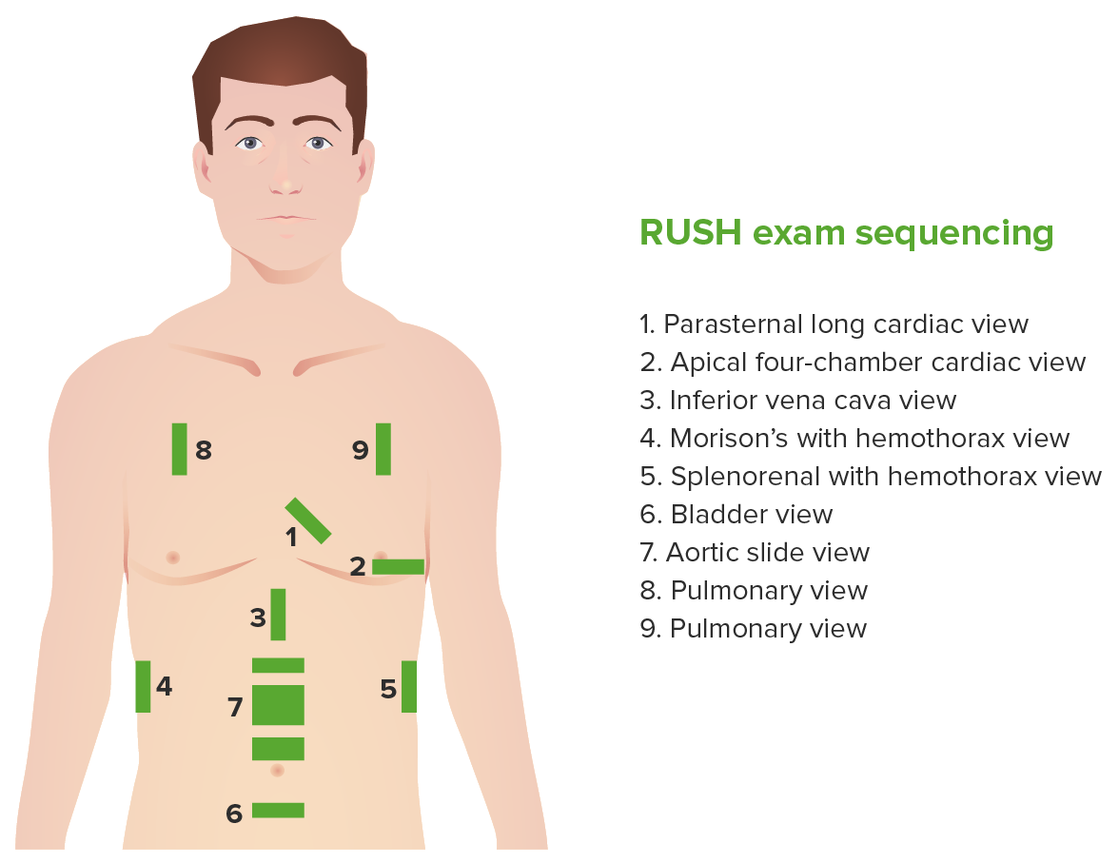
(high frequency probe)
(high frequency probe)
10. Lower extremity DVT scans (not pictured)
Image source: Lecturio.com
Notes:
Original RUSH exam: only views 1-9; many clinicians add on #10

Slide 13
 | Hypovolemic | Obstructive | Cardiogenic | Distributive
Pump | Hyperdynamic | Pericardial effusion (tamponade?) RV strain (PE) | Hypodynamic | Hyperdynamic
Tank | Flat IVC | Plethoric IVC | Plethoric IVC | Normal IVC
Pipes/source | AAA Intraperitoneal/ pelvic fluid Large pleural effusion (hemothorax) | Lung sliding absent (PNX) LE DVT (PE) | B lines in all lung fields | Normal

Slide 14
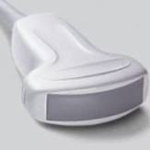
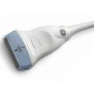
Probes to use
Use curvilinear or cardiac probe for views 1-7
Use linear probe for views 8-10

Slide 15
So let’s revisit our case…

Slide 16
Case #1
A 25/F HIV+ patient is brought to Casualty for altered mental status. From the little history you can obtain, she has had watery diarrhea for the last 3 weeks and has been bedbound for most of that time. On exam you note the following:
Temp 38.3C HR 120bpm RR 30/min BP 65/35mmHg O2 sat 93% RA
Gen: Thin, emaciated-appearing female patient
ENT: Pale conjunctivae
CV: Reg rhythm but tachycardic, 4/6 systolic murmur
Pulm: Tachypneic but clear bilaterally
Abd: Soft, NT, ND
Ext: 1+ ankle edema bilaterally
Neuro: GCS 7/15. Pupils equal, round, reactive bilaterally

Slide 17
This was her echo…

Slide 18
These were her lungs…

Slide 19
This was her IVC…

Slide 20
And…
No free fluid found in abdomen
No free fluid found in pelvis
No AAA seen
No DVT in either lower extremity found

Slide 21
What type of shock is most likely???
Notes:
yes

Slide 22
Answer…
HYPOVOLEMIC SHOCK!
Either from…
Chronic GI fluid losses
Severe anemia
Possibly SEPSIS as well

Slide 23
Management?
**BOLUS IV FLUIDS NOW!**
Check Hb now and prepare for transfusion!
Start empiric antibiotics, in case of sepsis!
Obtain diagnostic labs (FBC, U&Es, Cr, stool M/C/S, etc.)

Slide 24
for this case…
Would our findings be any different if the primary cause of shock was sepsis, instead of hypovolemia?

Slide 25
Answer…
Main difference on scanning:
NORMAL IVC!

Slide 26
Case #2
A 45yo HIV+ male presents to Casualty with a chief complaint of feeling faint, shortness of breath, and palpitations. He has had productive cough x 2 months, as well as intermittent fevers, and weight loss.
Temp 37C HR 120bpm RR 30/min BP 70/40mmHg O2 sat 95% RA
Gen: Thin, emaciated-appearing male patient
CV: Reg rhythm but tachycardic
Pulm: Tachypneic, bibasilar rales noted on auscultation
Abd: Soft, NT, ND
Neuro: GCS 15/15. Pupils equal, round, reactive bilaterally

Slide 30
And…
No free fluid found in abdomen
No free fluid found in pelvis
No AAA seen
No DVT in either lower extremity found

Slide 31
What type of shock is most likely???
Notes:
yes

Slide 32
Answer…
OBSTRUCTIVE SHOCK!
Due to cardiac tamponade!
Likely etiology: extra-pulmonary TB

Slide 33
Management?
Emergent pericardiocentesis!
Consult cardiology and/or cardiothoracic surgery
Start empiric anti-TB medication
Obtain diagnostic labs (FBC, U&Es, Cr, ECG, full echo, sputum GeneXpert, Urine LAM, CXR, etc.)
Stat Hb in case of hemopericardium

Slide 34
Case #3
A 55yo DM female presents to Casualty with a chief complaint of sudden onset chest pain, shortness of breath, and palpitations. Chest pain is worse with deep inspiration. She had surgery 3 weeks ago.
Temp 37C HR 120bpm RR 35/min BP 65/40mmHg O2 sat 80% RA
Gen: Older adult female in respiratory distress
CV: Reg rhythm but tachycardic
Pulm: Tachypneic, intercostal retractions bilaterally, lungs clear on auscultation
Abd: Soft, NT, ND
Neuro: GCS 15/15. Pupils equal, round, reactive bilaterally

Slide 35
These were her lungs…

Slide 39
What type of shock is most likely???
Notes:
yes

Slide 40
What if we found this in her R leg?

Slide 41
Answer…
OBSTRUCTIVE SHOCK!
Due to likely massive pulmonary embolism!

Slide 42
Management?
Oxygen supplementation + anticoagulation +/- TPA or thrombectomy
Consult vascular surgery
Obtain diagnostic labs (FBC, U&Es, Cr, ECG, full echo, PT/PTT/INR)

Slide 43
Case #4
A 35yo healthy male was involved in an RTA and is brought o Casualty with a chief complaint of chest pain, shortness of breath, and abdominal pain. He was an unrestrained driver and accidently drove into a bus in a head-on collision. He was thrown against the steering wheel forcefully, but managed to avoid any head injury.
Temp 37C HR 140bpm RR 35/min BP 65/40mmHg O2 sat 80% RA
Gen: Young adult male in respiratory distress, obvious pain
CV: Reg rhythm but tachycardic
Pulm: Tachypneic, absent breath sounds over R anterior lung fields
Abd: Distended, diffusely tender. +involuntary guarding noted
Neuro: GCS 15/15. Pupils equal, round, reactive bilaterally

Slide 44
lung us of r1

Slide 47
What type of shock is most likely???
Notes:
yes

Slide 48
Answer…
HYPOVOLEMIC + OBSTRUCTIVE SHOCK!
Hypovolemic: from traumatic intra-abdominal hemorrhage
Obstructive: from traumatic pneumothorax

Slide 49
Management?
Emergent R-sided needle thoracostomy → chest tube placement for PNX
2L IVL bolus now
Prepare for blood transfusion
Consult surgeon for emergent exploratory laparotomy!
Obtain diagnostic labs (FBC, U&Es, Cr, CXR, etc.)
Stat Hb given suspected hemorrhage

Slide 50
Case #5
A 33yo female without any known PMH was admitted to Chilenje female ward for palpitations, chest pain, and shortness of breath. When I began rounds, I found her in obvious distress and we began immediate assessment.
Temp 37C HR 160bpm RR 35/min BP 65/40mmHg O2 sat 70% RA
Gen: Young adult female in respiratory distress, clutching her chest
CV: Reg rhythm but tachycardic. Thready radial pulses bilaterally
Pulm: Tachypneic, intercostal retractions, but lungs clear
Abd: Soft, NT, ND
Neuro: GCS 15/15. Pupils equal, round, reactive bilaterally

Slide 51
cardiac: valve rupture

Slide 52
cardiac: Severe mitral regurgitation

Slide 53
Outcome
After IV access obtained and IV fluid bolus initiated, the patient went pulseless. Cardiac resuscitation was initiated with chest compressions and bag valve masking with oxygen. Epinephrine doses x3 were administered. After 5 rounds of resuscitation, unfortunately no return of spontaneous circulation occurred, and the patient was declared expired.
Suspected etiology: MV rupture with severe MR due to possible rheumatic heart disease

Slide 54
 | Hypovolemic | Obstructive | Cardiogenic | Distributive
Pump | Hyperdynamic | Pericardial effusion (tamponade?) RV strain (PE) | Hypodynamic | Hyperdynamic
Tank | Flat IVC | Plethoric IVC | Plethoric IVC | Normal IVC
Pipes/source | AAA Intraperitoneal/ pelvic fluid Large pleural effusion (hemothorax) | Lung sliding absent (PNX) LE DVT (PE) | B lines in all lung fields | Normal

Slide 55
references
Soni NJ, Arntfield R, Kory P. Point-of-Care Ultrasound, 2nd ed. Philadelphia, PA: Elsevier; 2020.
Schrift, D. Critical Care Ultrasound. University of South Carolina School of Medicine; 2019.

Slide 56
Questions?

